Slide 1
Decision Tree
Sadia Islam Assistant Professor
Department of Computer Science and engineering United International University

Slide 2
Decision Tree
Decision tree (DT) induction is the learning of decision trees from class-labeled training instances, which is a top-down recursive divide and conquer algorithm.
Advantages:
Simple to understand.
Easy to implement.
Requiring little prior knowledge.
Able to handle both numerical and categorical data.
Robust.
Dealing with large and noisy datasets.
Nonlinear relationships between features do not affect the tree performance.

Slide 3
Decision Tree
A decision tree works by breaking down a dataset into smaller subsets while at the same time an associated decision tree is incrementally developed. The final result is a tree with decision nodes and leaf nodes. Process:
Root Node: This is the topmost node in a decision tree. It represents the entire dataset
Splitting: This involves dividing a node into two or more sub-nodes. The split is based on features in the data set. The aim is to ensure that the resulting sub-nodes are as pure (homogeneous) as possible.
Decision Nodes: They represent features in the dataset and the possible values they can take and gets divided based on certain conditions.
Leaf/Terminal Nodes: These nodes represent the final output or decision. They are the nodes where no further splitting is possible or necessary.
Pruning: Done to reduce the size of the tree.
Predicting: The final part, predicting values of the test data.

Slide 4
Decision Tree
Building a Decision Tree: Different algorithms can be used like ID3, C4.5, or CART.

Slide 5
Iterative Dichotomiser 3 (ID3)
Calculate Entropy of the Target Variable
  Calculate the randomness
Calculate Information Gain for Each Attribute
Select the Best Attribute for the Root Node
  Choose the attribute with the highest information gain as the root node.
Split the Dataset
  Split the dataset into subsets based on the values of the chosen attribute
Recursively Build the Tree
  Continue this process until all instances in a subset belong to the same class or no more attributes are left to split on
Classify New Instances

Slide 6
Iterative Dichotomiser 3 (ID3)
Information gain of an attribute =
Information of the output variables - information of an attribute
Here, we are expressing information in terms of entropy(randomness), the less entropy an attribute has, the more effective the attribute is in terms of splitting the data towards more decisive output, the more gain it has

Slide 7
Iterative Dichotomiser 3 (ID3)
Entropy for any random variable having k values
Binary random variable

Slide 8

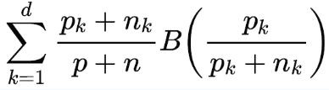
Iterative Dichotomiser 3 (ID3)
Information Gain of an attribute A = Entropy of output variable - Entropy of that attribute
IG(A) = Info_{output}- Info_{A} Info_{output}= Entropy_{output} =
Where, p is the number of positive cases and n is the number of negative cases Info_{A}= Entropy_{A} =
Where, p_{k} and n_{k} are the number of positive and negative instances respectively for attribute value = k and d is the total number of values for the attribute

Slide 9
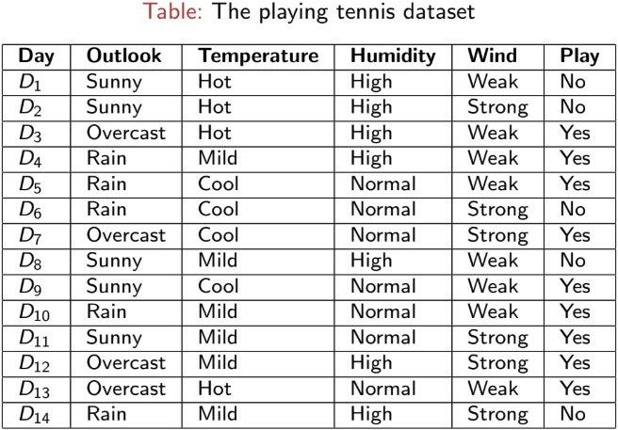
Example - Dataset

Slide 10

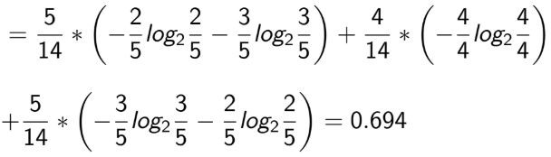
ID3 - Information Gain calculation
^{Info}output⁼
, Information gain of target variable
Information(entropy) of the attribute “Outlook”
^{Info}Outlook
Information Gain = Info_{output}-Info_{outlook} = 0.940 − 0.694 = 0.246

Slide 11
Same way, the IG of Outlook = 0.246, Temperature = 0.086, Humidity = 0.154, and Wind = 0.197.
ID3
So, we will divide the dataset based on Outlook first.

Slide 12
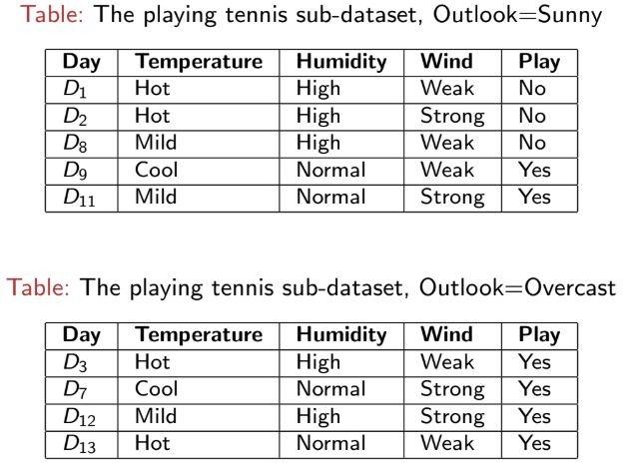
ID3

Slide 13
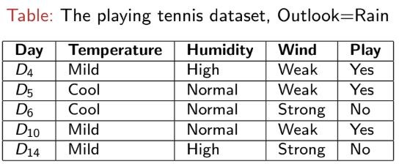
ID3

Slide 14
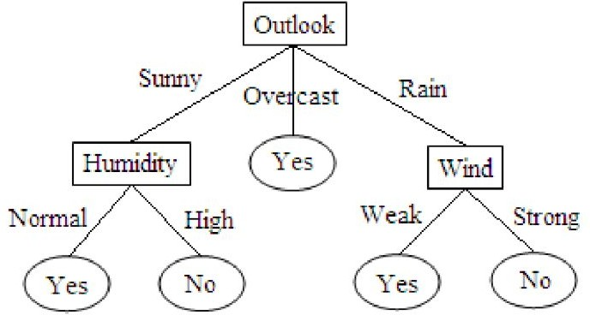
Decision Tree

Slide 15
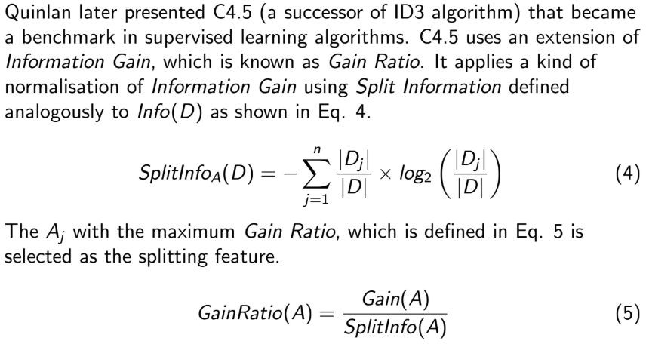
C4.5

Slide 16
C4.5 - example for the same dataset
Steps:
Calculate Information Gain for each attribute.
Calculate Split Information for each attribute.
Calculate Gain Ratio and select the attribute with the highest Gain Ratio for splitting.

Slide 17
C4.5 - example for the same dataset
Step 1 is already complete, IG(S, Outlook) = 0.246
Look at the previous slides
○

Slide 18

C4.5 - example for the same dataset
Step 2: Split Information for ”Outlook”

Slide 19
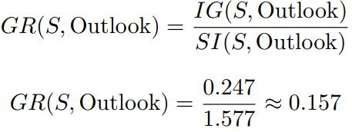
C4.5 - example for the same dataset
Step 3: Gain Ratio for ”Outlook”
Similarly, find GR for all the attributes and select the one with the highest value to split the data.

Slide 20

CART( Classification And Regression Trees)
CART( Classification And Regression Trees) is a variation of the decision tree algorithm. It can handle both classification and regression tasks.
Gini index/Gini impurity
The Gini index is a metric for the classification tasks in CART. It stores the sum of squared probabilities of each class. It computes the degree of probability of a specific variable that is wrongly being classified when chosen randomly and a variation of the Gini coefficient.

Slide 21
CART( Classification And Regression Trees)
The degree of the Gini index varies from 0 to 1,
Where 0 depicts that all the elements are allied to a certain class, or only one class exists there.
Gini index close to 1 means a high level of impurity, where each class contains a very small fraction of elements, and
A value of 1-1/n occurs when the elements are uniformly distributed into n classes and each class has an equal probability of 1/n. For example, with two classes, the Gini impurity is 1 – 1/2 = 0.5.

Slide 22
CART for Classification
Gini Impurity- Gini impurity measures the probability of misclassifying a random instance from a subset labeled according to the majority class. Lower Gini impurity means more purity of the subset.
Splitting Criteria- The CART algorithm evaluates all potential splits at every node and chooses the one that best decreases the Gini impurity of the resultant subsets. This process continues until a stopping criterion is reached, like a maximum tree depth or a minimum number of instances in a leaf node.

Slide 23
CART for Regression
Residual Reduction- Residual reduction is a measure of how much the average squared difference between the predicted values and the actual values for the target variable is reduced by splitting the subset. The lower the residual reduction, the better the model fits the data.
Splitting Criteria- CART evaluates every possible split at each node and selects the one that results in the greatest reduction of residual error in the resulting subsets. This process is repeated until a stopping criterion is met, such as reaching the maximum tree depth or having too few instances in a leaf node.

Slide 24
CART Example
Study Hours | Attendance (%) | Final Grade (Pass/Fail)
10 | 85 | Pass
8 | 78 | Pass
4 | 50 | Fail
6 | 65 | Pass
3 | 40 | Fail
1. Choose the Splitting Attribute.
Considering the Study Hours = 6.5 as mid to split.
Left Node (Study Hours ≤ 6.5): (3, 40, Fail)(4, 50, Fail)(6, 65, Pass)
Right Node (Study Hours > 6.5): (8, 78, Pass)(10, 85, Pass)

Slide 25
CART Example
2. Calculate Gini Impurity
Left Node:
Probability of Fail = ⅔ Probability of Pass = ⅓
Gini = 1 - (2/3)^2 - (1/3)^2 ≈ 0.44
Right Node:
Probability of Pass = 2/2 = 1 Gini = 1 - (1)^2 = 0

Slide 26
CART Example
Tree
Study Hours ≤ 6.5
/
Fail/pass (3, 4,6)
\
Pass
(8, 10)

Slide 27
Arigato Gujaimas

